Slide 1

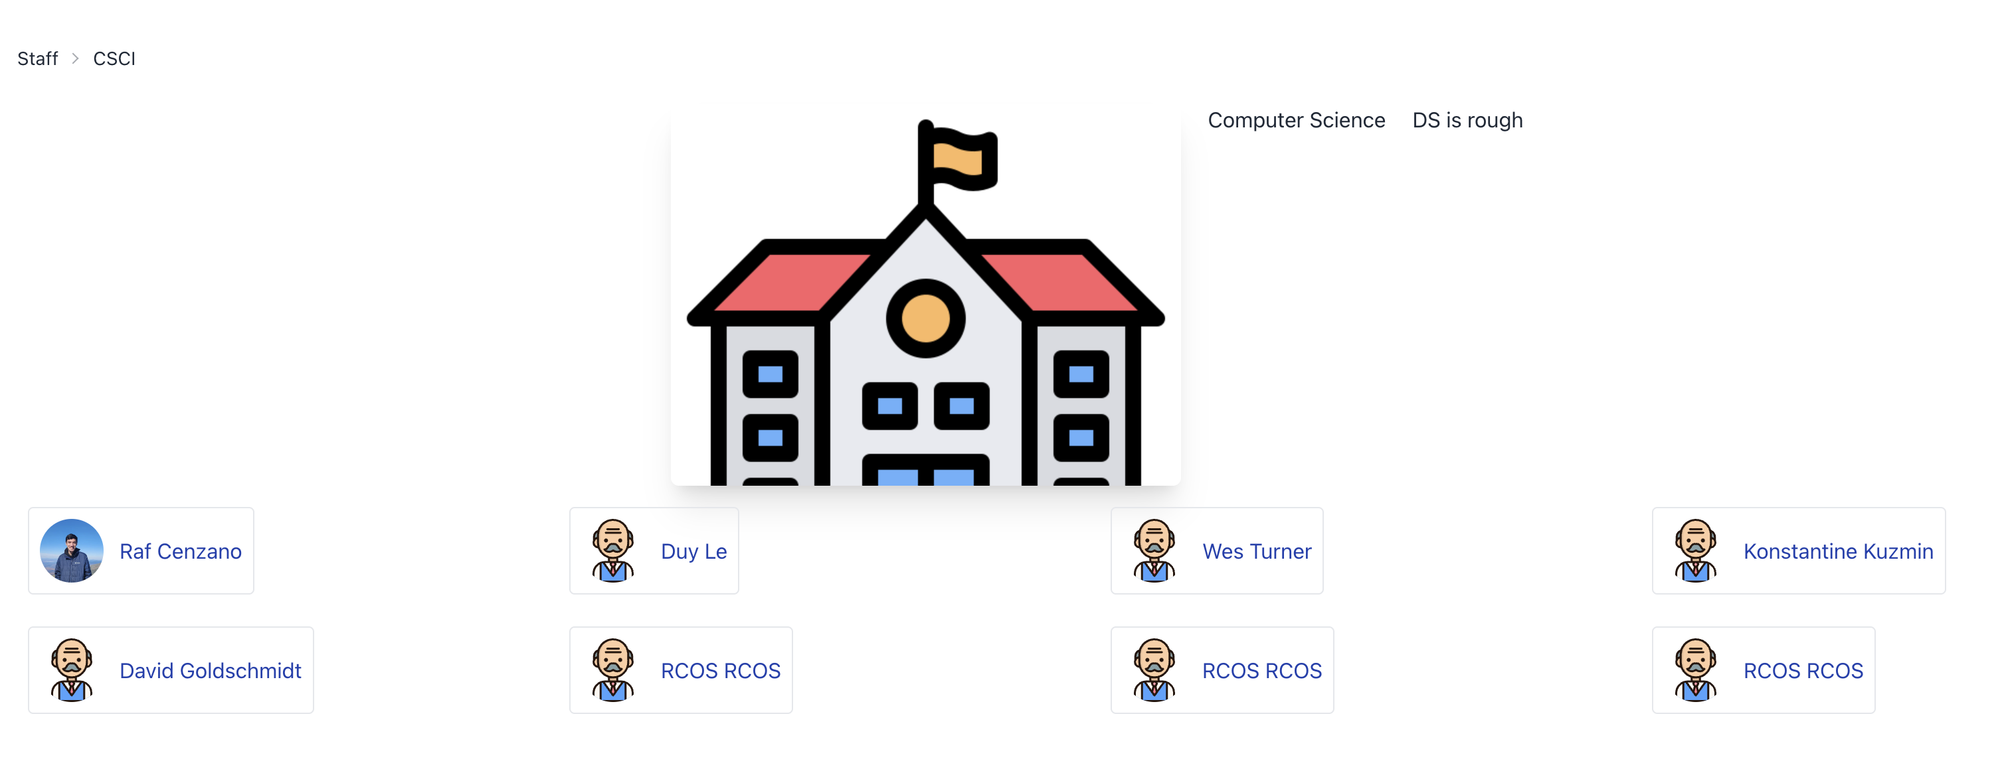
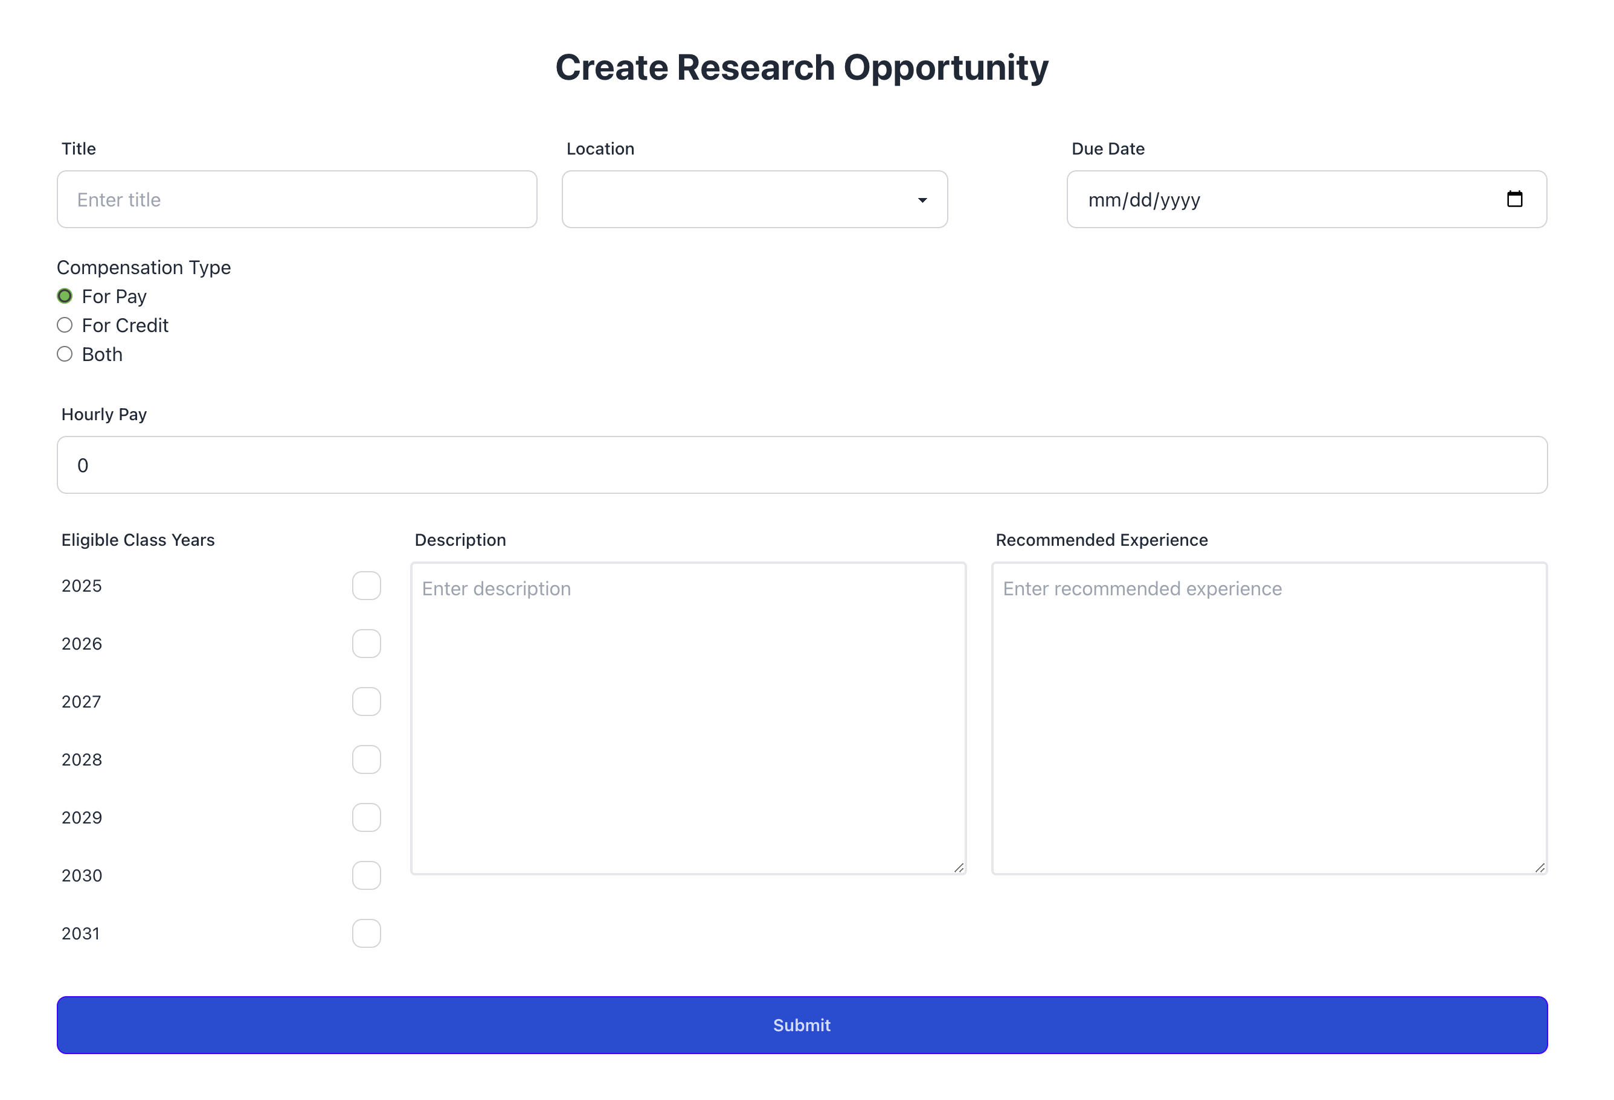
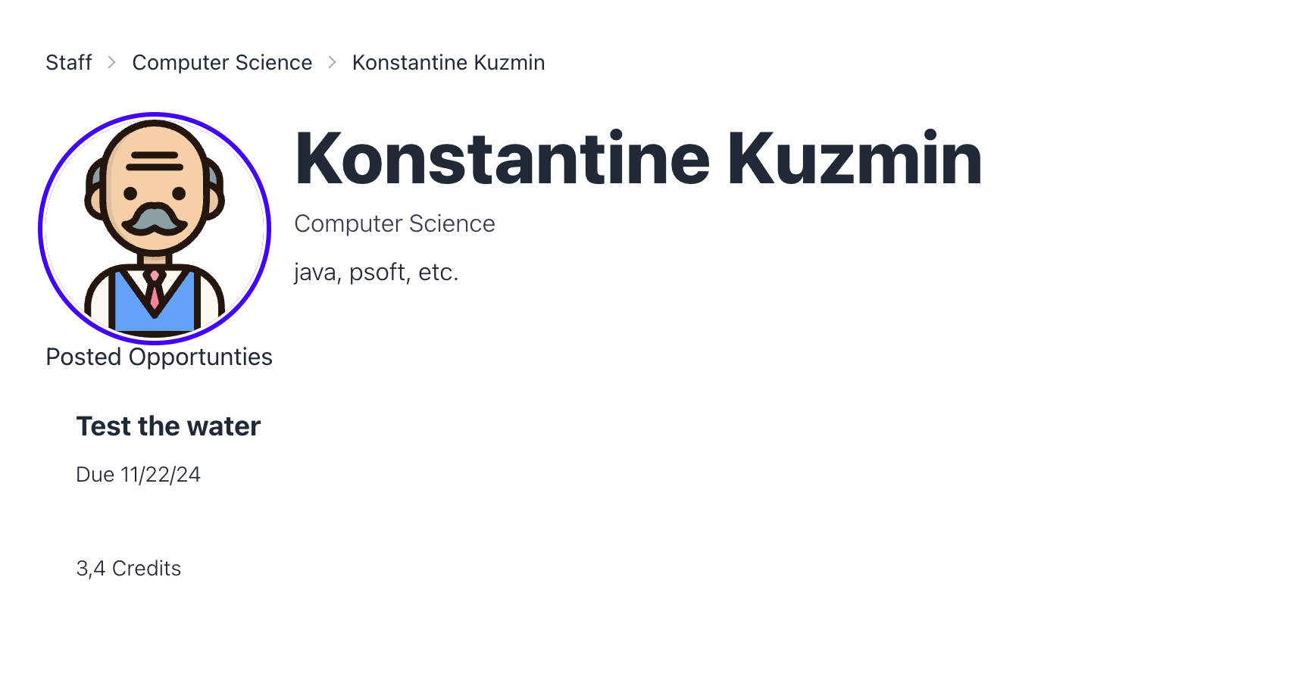
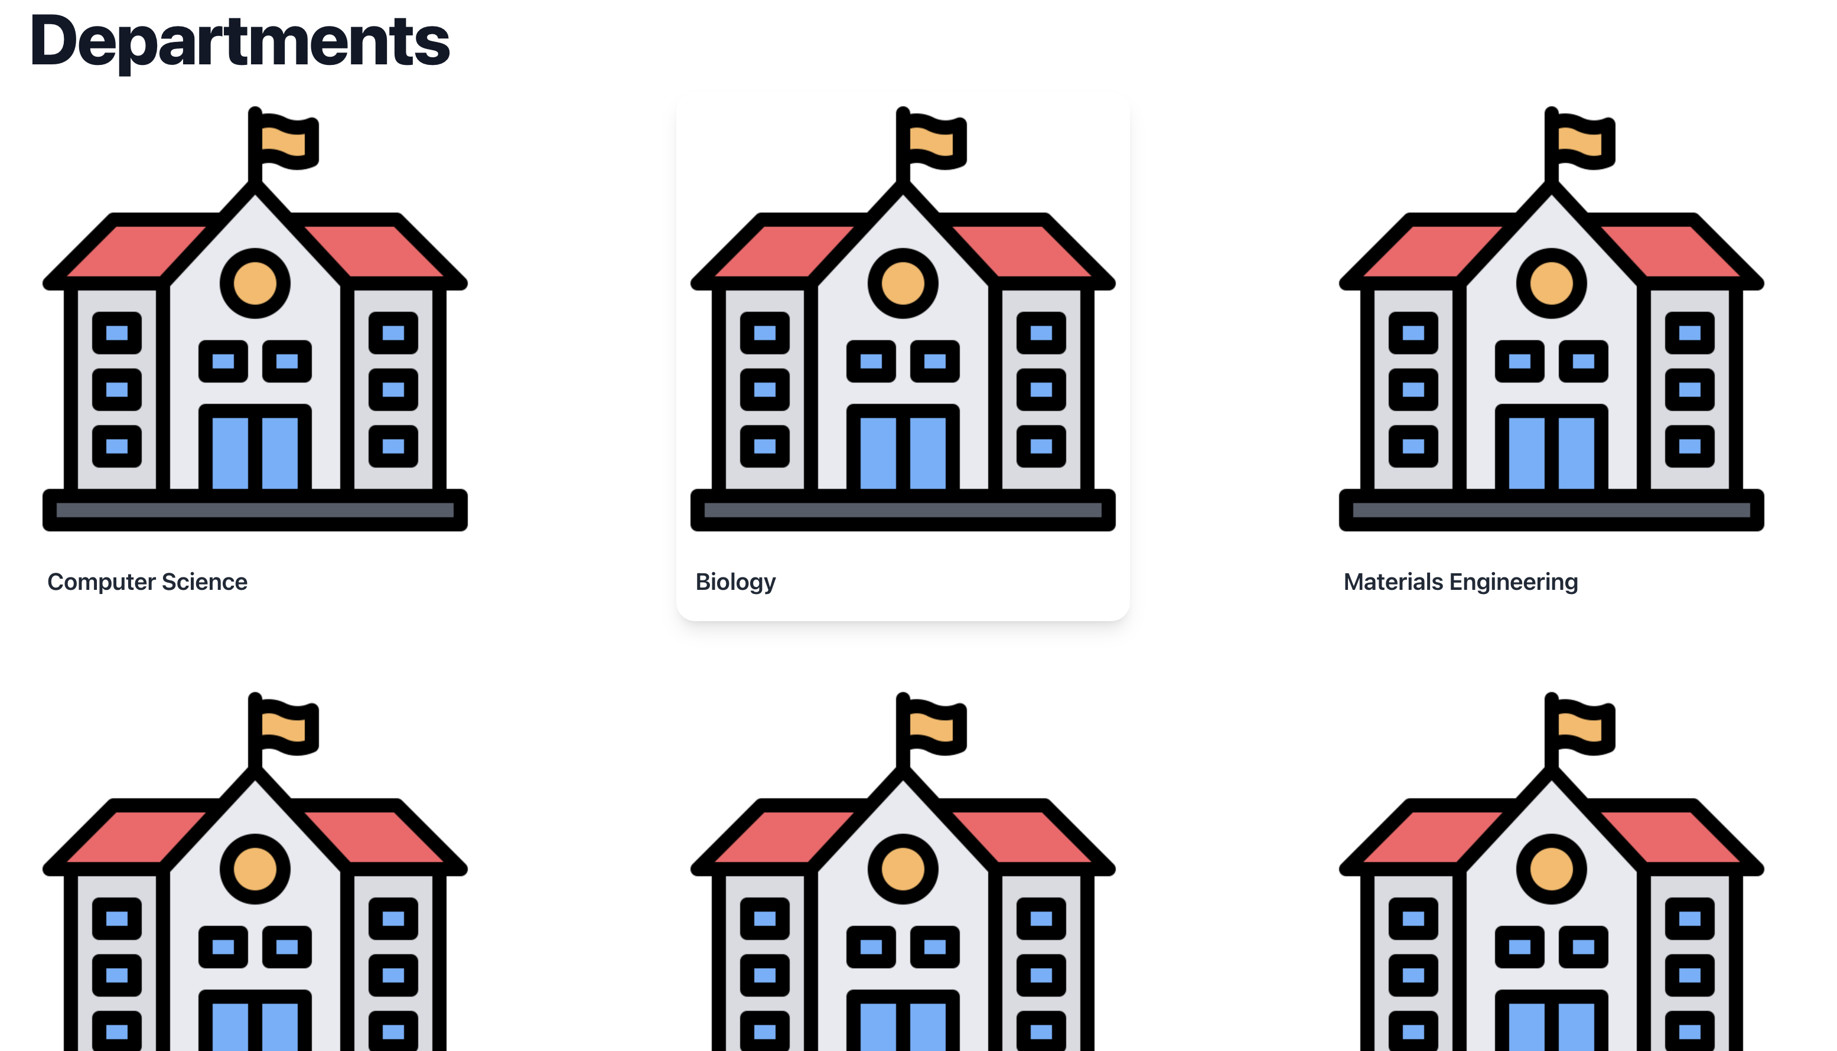








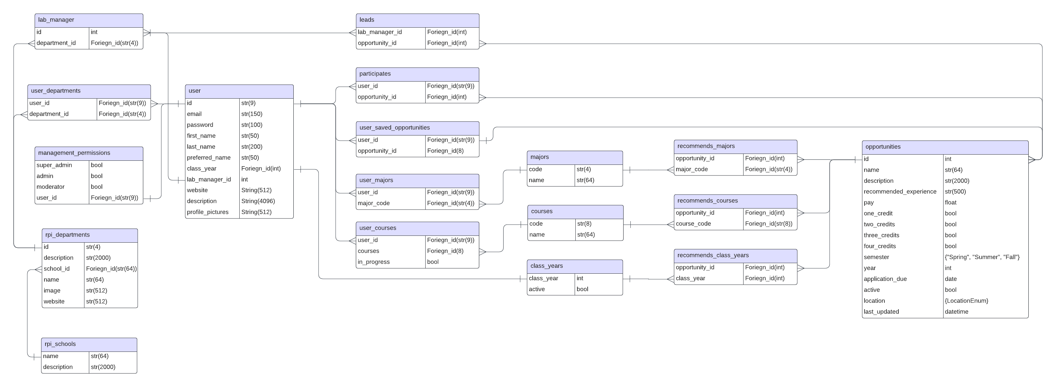
LabConnect: Connecting Students with Research Opportunities
Rafael Cenzano (Lead), Siddhi Wadekar, Mrunal Athaley, William Broadwell, Ramzey Youssef, Sarah Wohlford, Sidharth Eage
Introduction
Objectives
LabConnect aims to connect undergraduate students with research opportunities through the following goals:
Centralized Listings:
Provide a platform for faculty to post research positions.
Include essential details such as skills, credits, pay, department, and workload.
Ensure all information is easily accessible in one place.
Tailored Search and Matching:
Enable students to efficiently find opportunities that match their interests and skills.
Use advanced search and filtering options for precise results.
Match students with suitable positions through a well-structured database.
Simplified Management and User-Friendly Design:
Reduce administrative burdens with intuitive tools for posting and managing positions.
Enable faculty to focus more on research.
Provide a simple, accessible interface for both students and faculty.
LabConnect is a web-based platform designed to bridge the gap between students and research opportunities at Rensselaer Polytechnic Institute (RPI). By streamlining the process of posting and finding lab positions, LabConnect aims to make research more accessible for students and reduce administrative overhead for faculty. This project emphasizes creating a centralized, user-friendly portal tailored to the unique needs of the RPI community. The platform prioritizes efficiency, usability, and scalability, ensuring students and faculty have a seamless experience connecting with one another.
Website Page
Website Pages
Results
Conclusion
Add your information, graphs and images to this section.
Technologies Used:
LabConnect's development has overcome key challenges and achieved significant milestones:
Frontend-Backend Integration and Authentication:
Ensured seamless communication between React and Flask.
Overcame challenges through API design, testing, and OAuth framework adaptation.
Dynamic Frontend and Optimized Backend:
Developed a React frontend with advanced search and filtering.
Interface remains intuitive, with ongoing TypeScript migration.
Flask ensures secure, fast API responses; PostgreSQL optimizes queries.
Current Progress:
LabConnect is functional with optimized search and a streamlined application portal.
Ongoing work includes completing SSO integration and migrating to TypeScript.
LabConnect has been an enriching experience, enhancing technical and teamwork skills:
Web Development and Database Proficiency:
Built with React, Flask, and PostgreSQL for scalable systems.
Optimized the database for efficient queries and seamless integration.
Authentication and User-Focused Design:
Implementing RPI Single Sign-On for secure access.
Designed an intuitive interface to balance security with usability.
Teamwork and Continuous Learning:
Collaborated on overcoming challenges and enhancing features.
Explored new technologies like TypeScript, fostering ongoing innovation.
Acknowledgements
RCOS Community RPI CS Faculty and Staff
Resources and Documentation
Database Schema

